Slide 1
Vanishing Gradients

Slide 2
Vanishing Gradients
Backpropagation goes backwards from the output to the input layer, propagating the error gradient.
For deeper networks issues can arise from backpropagation, vanishing and exploding gradients!
As you go back to the “lower” layers, gradients often get smaller, eventually causing weights to never change at lower levels.
The opposite can also occur, gradients explode on the way back, causing issues.

Slide 3
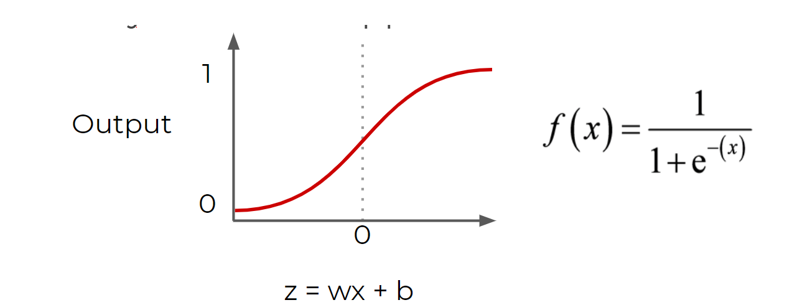
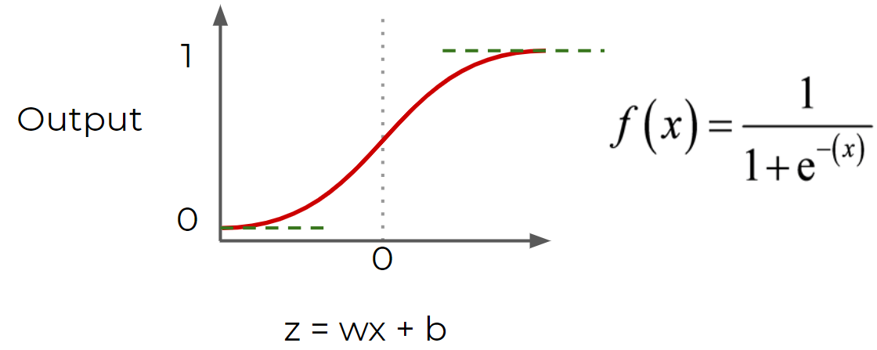
Vanishing Gradients – Why this happens?

Slide 4
We compute the gradient by using the chain rule.
Input will be passed into the activation function, the input usually is quite large. The gradient (or the slope) coming out of this activation function ends up being very close to zero.
It’s the same deal if you have really large negative numbers.
This chain rule of back propagation computed gradient has the effect of multiplying n of these small numbers to compute gradients of these lower (or front layers) in a network.
The gradient is going to decrease exponentially with n as you got more and more layers while the front layers is trained very slowly because you multiply these numbers over and over again which is going to lead to smaller numbers.

Slide 5
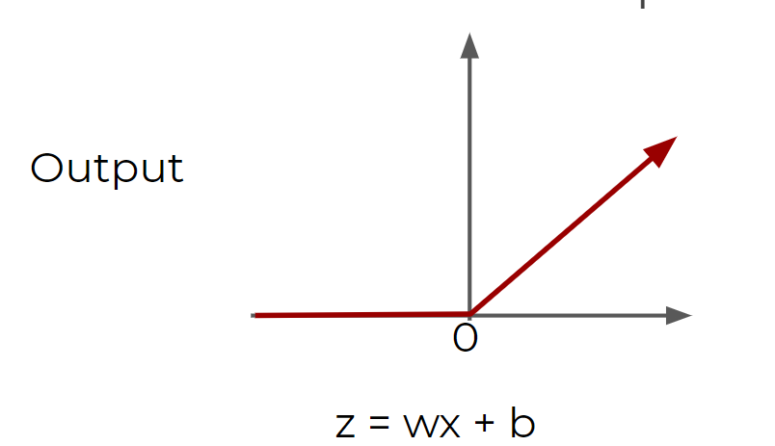
Vanishing Gradients – Solutions
Using different activation functions
1. ReLu: the ReLu doesn’t saturate positive values.

Slide 6
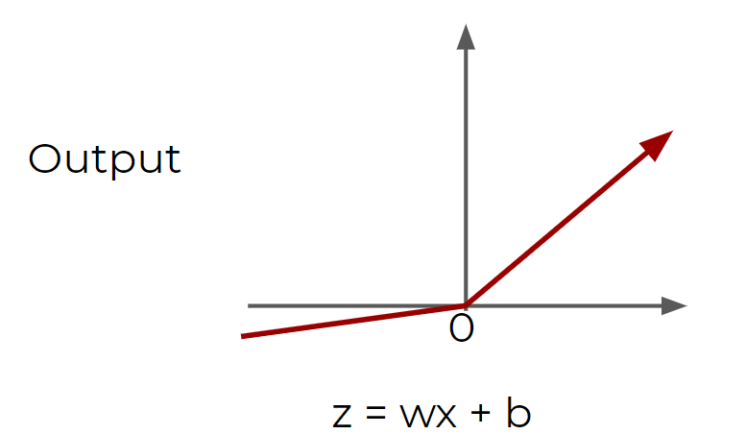
Vanishing Gradients – Solutions
2. ‘Leaky ReLu’
keras.layers.LeakyReLU(alpha=0.3)

Slide 7
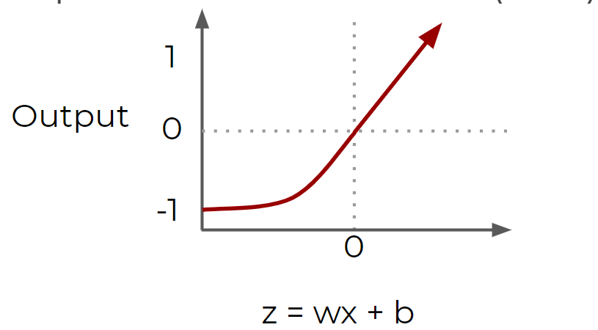
Vanishing Gradients – Solutions
3. Exponential Linear Unit (ELU)

Slide 8
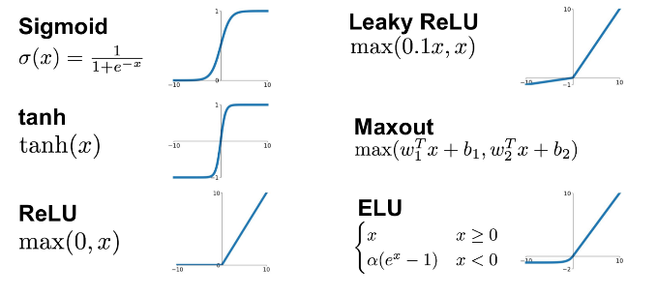
Quick Review - Activation Functions

Slide 9
Vanishing Gradients – Solutions
Another solution is to perform batch normalization, where your model will normalize each batch using the batch mean and standard deviation.
Apart from batch normalization, researchers have also used “gradient clipping”, where gradients are cut off before reaching a predetermined limit (e.g. cut off gradients to be between -1 and 1)

Slide 10
LSTM

Slide 11
Many of the solutions previously presented for vanishing gradients can also apply to RNN: different activation functions, batch normalizations, etc…
However because of the length of time series input, these could slow down training
A possible solution would be to just shorten the time steps used for prediction, but this makes the model worse at predicting longer trends.
Another issue RNN face is that after awhile the network will begin to “forget” the first inputs, as information is lost at each step going through the RNN.
We need some sort of “long-term memory” for our networks.

Slide 12
LSTM
The LSTM (Long Short-Term Memory) cell was created to help address these RNN issues.(1997)

Slide 13
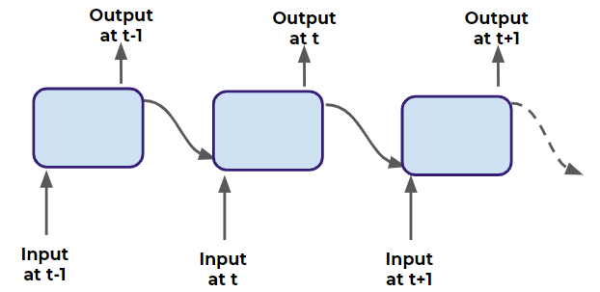
A Typical RNN

Slide 14
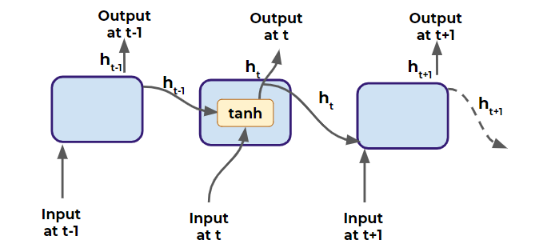
A Typical RNN Cell

Slide 15
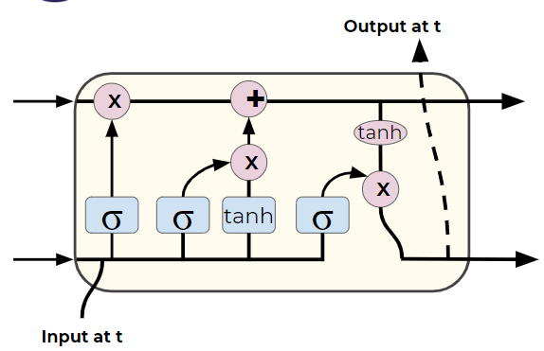
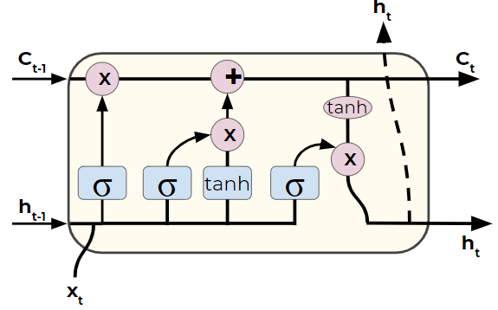
The Entire LSTM Cell
Ct-1

Slide 16
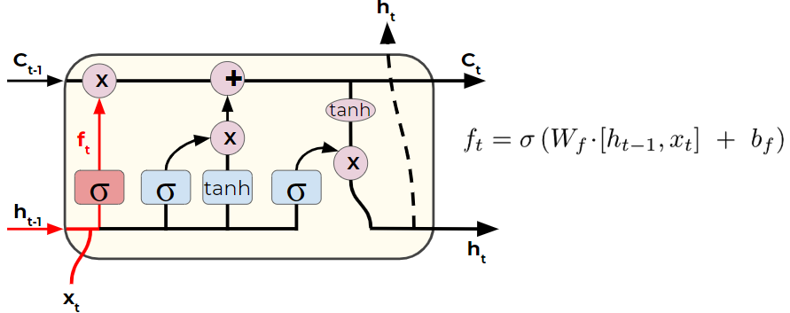
An LSTM Cell

Slide 17
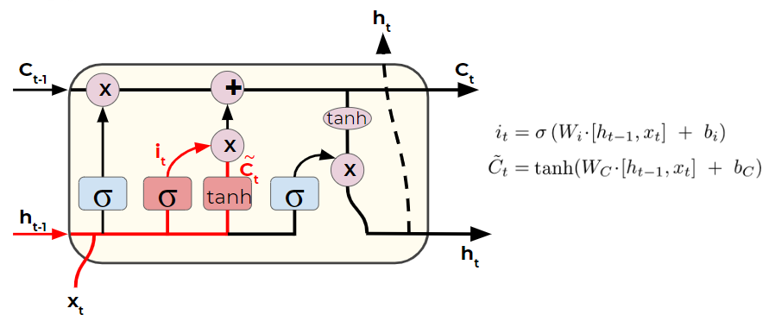
An LSTM Cell

Slide 18
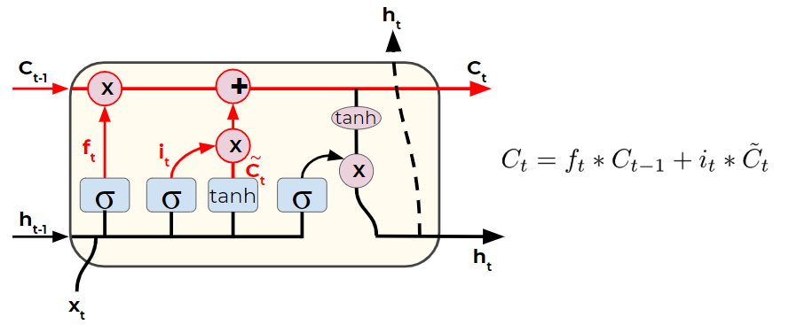
An LSTM Cell

Slide 19
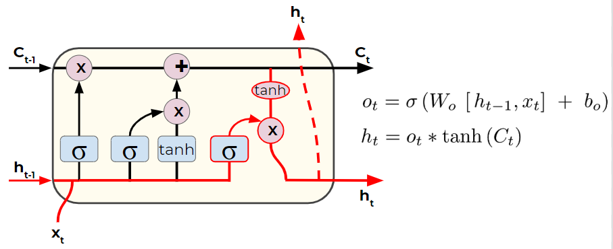
An LSTM Cell

Slide 20
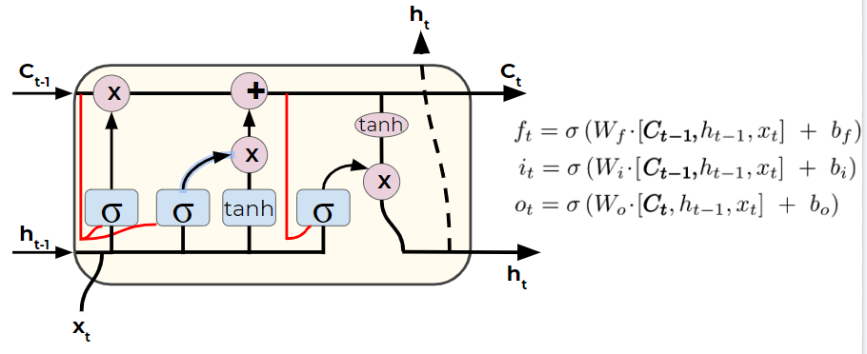
An LSTM Cell with “peepholes”

